Slide 1
Project Cysera
Hardware Configuration
Drafted by Zoebir Bong

Slide 2
Proposed configurations
Configuration 1 : Dell PowerEdge R720XD with remote data storage
Configuration 2 : Dell PowerEdge R720XD with local data storage
Configuration 3 : Lenovo System x3650 M5 with remote data storage
Configuration 4 : Lenovo System x3650 M5 with local data storage
Configuration 5 : Lenovo NeXtScale nx360 M5 with remote data storage
Configuration 6 : Lenovo NeXtScale nx360 M5 with local data storage

Slide 3
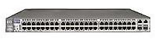
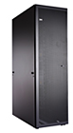
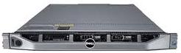
Configuration 1
Dell PowerEdge R620 – Remote Data Storage
2x Network switch
1x 1GbE 48-port network switch (for Management)
1x 10GbE 48-port network switch (for Data and Intercommunication)
1x 42U Rack
With rear door heat exchanger
2x PDU
Power cords
10x Dell PowerEdge R620
1U server
2x Intel Xeon E5-2650 v2 (8-core)
24x 4GB DDR3 1600MHz memory
2x 500GB 2.5” HDD (RAID-1) for OS
2-port 1 GbE network card
2-port 10 GbE network card

Slide 4
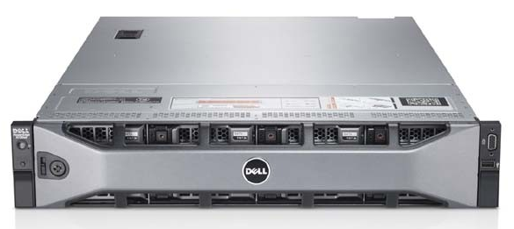
Configuration 2
Dell PowerEdge R720XD – Local Data Storage
2x Network switch
1x 1GbE 48-port network switch (for Management)
1x 10GbE 48-port network switch (for Data and Intercommunication)
1x 42U Rack
With rear door heat exchanger
2x PDU
Power cords
10x Dell PowerEdge R720XD
2U server
2x Intel Xeon E5-2650 v2 (8-core)
24x 4GB DDR3 1600MHz memory
2x 500GB 2.5” HDD (RAID-1) for OS
24x 500GB 2.5” HDD for Data
2-port 1 GbE network card
2-port 10 GbE network card

Slide 5
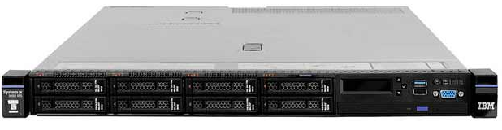
Configuration 3
Lenovo x3550 M5 – Remote Data Storage
2x Network switch
1x 1GbE 48-port network switch (for Management)
1x 10GbE 48-port network switch (for Data and Intercommunication)
1x 42U Rack
With rear door heat exchanger
2x PDU
Power cords
10x Lenovo x3550 M5
1U server
2x Intel Xeon E5-2650 v2 (8-core)
24x 4GB DDR3 1600MHz memory
2x 500GB 2.5” HDD (RAID-1) for OS
2-port 1 GbE network card
2-port 10 GbE network card

Slide 6
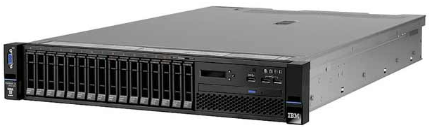
Configuration 4
Lenovo x3650 M5 – Local Data Storage
2x Network switch
1x 1GbE 48-port network switch (for Management)
1x 10GbE 48-port network switch (for Data and Intercommunication)
1x 42U Rack
With rear door heat exchanger
2x PDU
Power cords
10x Lenovo x3650 M5
2U server
2x Intel Xeon E5-2650 v2 (8-core)
24x 4GB DDR3 1600MHz memory
2x 500GB 2.5” HDD (RAID-1) for OS
24x 500GB 2.5” HDD for Data
2-port 1 GbE network card
2-port 10 GbE network card

Slide 7
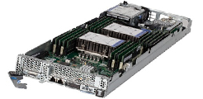
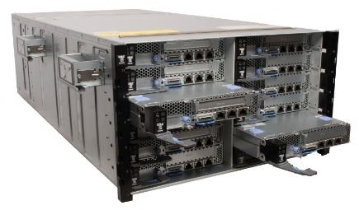
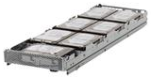
Configuration 5
Lenovo NeXtScale nx360 M5 – Local Data Storage
2x Network switch
1x 1GbE 48-port network switch (for Management)
1x 10GbE 48-port network switch (for Data and Intercommunication)
6x Lenovo NeXtScale nx360 M5
1U/Half width server
2x Intel Xeon E5-2650 v3 (10-core)
6x 16GB DDR4 memory
2x 500GB 2.5” HDD (RAID-1) for OS
2-port 1 GbE network card (Built-in)
2-port 10 GbE network card (via ML2)
1x 42U Rack
With rear door heat exchanger
2x PDU
Power cords
1x Chassis
6x 900W/1300W power modules
1x Lenovo NeXtScale n1200 enclosure chassis
6x Lenovo Storage Native Expansion Tray
1U/Half width server
RAID card ?
7x 3.5” 4TB/6TB HDD

Slide 8
Configuration 6
Lenovo NeXtScale nx360 M5 – Remote Data Storage
2x Network switch
1x 1GbE 48-port network switch (for Management)
1x 10GbE 48-port network switch (for Data and Intercommunication)
12x Lenovo NeXtScale nx360 M5
1U/Half width server
2x Intel Xeon E5-2650 v3 (10-core)
6x 16GB DDR4 memory
2x 500GB 2.5” HDD (RAID-1) for OS
2-port 1 GbE network card (Built-in)
2-port 10 GbE network card (via ML2)
1x 42U Rack
With rear door heat exchanger
2x PDU
Power cords
1x Chassis
6x 900W/1300W power modules
1x Lenovo NeXtScale n1200 enclosure chassis

